Slide 1
“AI could deliver $13Trillion in additional global economic activity by 2030, putting it…on par with… the introduction of other transformative technologies such as the steam engine.” McKinsey Global Institute

Slide 2
AI - Past, Present, Future
Karen McCann,
AI Strategist, AI Now-RTP
11/10/2018

Slide 3
AI Now - RTP
Agenda :
Why listen to me?
Group Introductions
AI – Past, Present, Future
AI Now-RTP
Questions
11/10/2018

Slide 4
AI Now - RTP
Karen McCann, PMP, PMI-ACP
AI Strategist
ML software development
Speaker, AI and ML topics
Founder, AI Now-RTP
15+ year career in leading edge technology development
11/10/2018

Slide 5
AI Now - RTP
Group Introductions
Who are you?
Why are you here?
11/10/2018

Slide 6
AI Now - RTP
Why Artificial Intelligence?
Changing the world
Faster than we can manage it
How do we respond?
11/10/2018

Slide 7
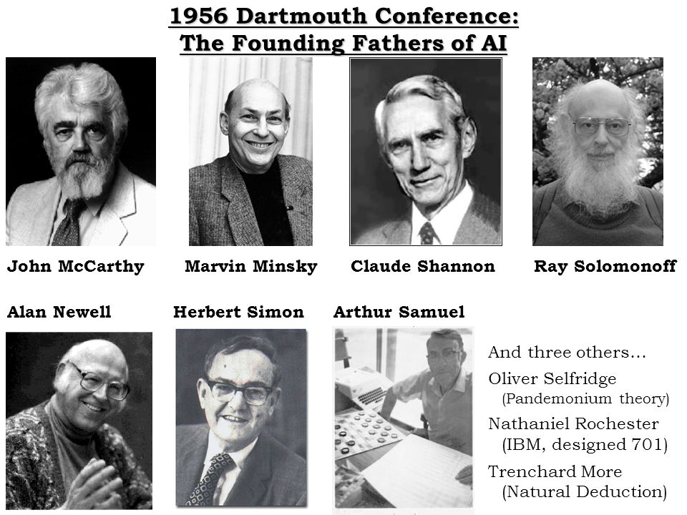
AI - Past
History of AI
1956 - Dartmouth sponsored a workshop “Dartmouth Summer Research Project on Artificial Intelligence”
11 brilliant mathematicians and scientists inc:
Dr. Marvin Minsky (MIT), legend in computing
Dr. John McCarthy (Stanford, Dartmouth) –
Coined term “artificial intelligence”
Received the Turing Award for his contributions to AI
Dr. Ray Solomonoff (Univ. of Chicago - the father of
algorithmic probability)
Wrote a paper that became basis of AI - “An Inductive
Inference Machine”
Pursued how to make machines generally more intelligent
(using probability)

Slide 8
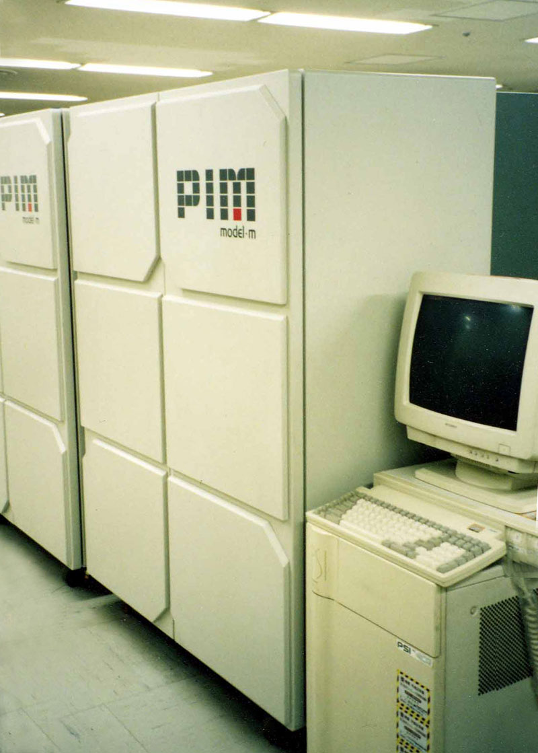
1981 – “Fifth Generation computer project” (Japan)
From performing simple calculations to developing a computer that would reason
From 1981 – 1991, computing technology drastically changed
After 10 years and $400M (i.e. billions today), project was declared a failure in 1992
Benefits –
Developed prototypes that performed reasoning functions at high speeds, due to massive amounts of parallel processing
Also, trained thousands of engineers in advanced computer science
Technical basis for many Japanese industries

Slide 9
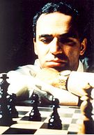
1997 – IBM’s Deep Blue
Chess playing computer
Won against Garry Kasparov
Reigning chess world champion
Development began in 1985 (Carnegie Mellon)
Basis was brute force computing
Massively parallel system with 30 nodes, each with 480 special purpose VLSI chess chips per node
Capable of evaluating 200M chess positions per second
Optimal values of moves were determined by instant comparison against a library of 700,000 grandmaster games

Slide 10
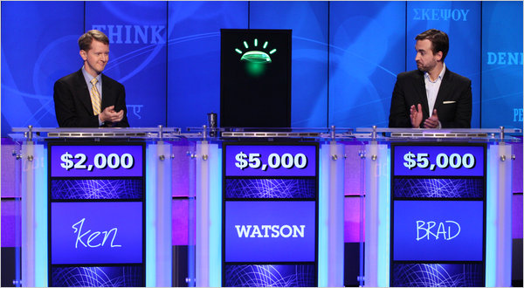
2011 – Watson wins Jeopardy
IBM’s Watson computer played and won against Jeopardy champions Ken Jennings and Brad Rutter
Proved that IBM had made major progress in intelligent machines
These machines could understand and respond to humans using natural language processing
https://www.youtube.com/watch?v=P18EdAKuC1U (start at 2:22)
“I, for one, welcome our new computer overlords”

Slide 11
AI - Present
Confluence of 4 trends through drastic improvements in
Computing Power (Moore’s law)
Machine Learning Techniques
Industrial design of robots (new materials and methods)
Machine perception (interpret visual images much higher accuracy)

Slide 12



Disruption of industries
Taxis into Uber
Hotels into AirBnB
Grocery stores into Amazon Go stores
Current AI/ML systems
There is no limitation to how expert ML systems can become
Internet provides access to unlimited data sets to learn from
Freed from human dependence to collect and feed data
Rapidly exceed the capabilities of their creators

Slide 13
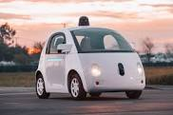
Self-driving cars
Concept has existed for decades
Serious development and testing in last 5 yrs
Leading companies – Waymo, Tesla, Uber, GM
To date, self-driving fleets have driven millions of miles on public roads and in simulations
US Govt. Regulation supporting commercialization
USDoT creating V-to-V (vehicle-to-vehicle) comm. protocol standards
Developed specifically for automotive applications
Car will become part of a network
Integrated flexible public transportation system (same as cell phones)
Demo of Waymo https://www.youtube.com/watch?v=uHbMt6WDhQ8

Slide 14
Other AI applications
Game changer for cancer
https://www.youtube.com/watch?v=HkEOJnn_zlg
Salesforce Einstein
https://www.youtube.com/watch?v=dYX4SWPrZzo
(Start at 2:00)
New client - Hyundai Credit Card
Using Watson to support an intelligent agent application for credit card users
https://www.hyundaicard.com/cpu/cs/CPUCS0201_01.hc

Slide 15
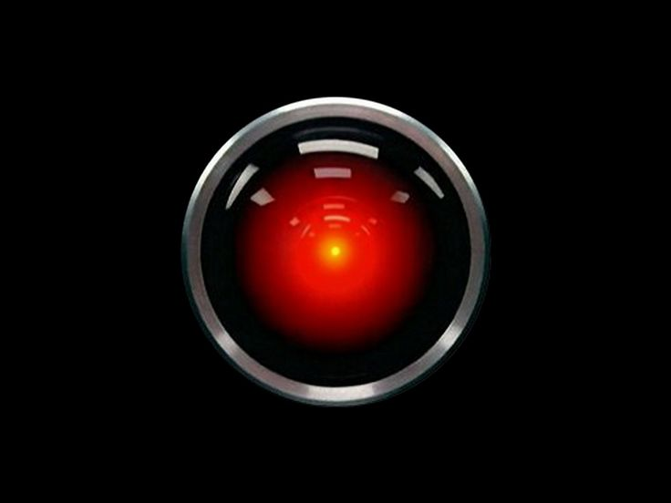
Not everything goes well
Hal from “2001 – A Space Odyssey”
2010 Flash Crash
Major US stock exchanges dropped 9% (over$1 Trillion in value) in 36 min
Caused by high-frequency trading between competing computer systems
2018 Uber Self-driving car
Hits and kills pedestrian in Arizona

Slide 16
AI - Future
The AI Age – Results on humans
May 2017 Pew Research Center : “In 1881, electricity transformed society; By 2020, AI will be as transformative (mystifying, shocking, and scary)”
http://www.elon.edu/docs/eweb/imagining/surveys/2016_survey/Future%20of%20Jobs%20Skills%20Education%205_3_17%20Elon%20Pew.pdf
10x as many professional jobs will be automated as manufacturing jobs today
AI will beat humans in job skills with speed and volume in :
Learning
Processing information
Matching patterns, and
Produce wide arrays of alternatives to problems

Slide 17
The impact on human work
As AI and robots improve, they will support more applications within all industries
Robots were originally created to perform jobs dangerous to humans
Now they are being created for economic efficiency to replace expensive human workers across all sectors
By 2021 (within 3 years), robots will eliminate 6% of all jobs
By 2030, robots will eliminate 38% of all jobs
At the World Economic Forum 2017, as much as 47% of all jobs were predicted
http://www.latimes.com/business/la-fi-pwc-robotics-jobs-20170324-story.html

Slide 18
https://willrobotstakemyjob.com/
Source : US Bureau of Labor and Statistics and their O*Net Resource data center
For given profession, % of humans replaced by robots -
Highest risk
Taxi drivers – 89%
Retail clerks - 97%
Medium risk
Construction workers – 71%
Truck Drivers – 70%
Lowest risk
Teachers – 1%
Dentists – 1%
Computer Research Scientists – 1%

Slide 19
Every physical task will be performed by a robot
Personal services examples
Painting houses
Cooking meals
Walking dogs
Shopping
Industrial services examples
Stocking shelves
Laying pipe
Fighting fires
Military applications examples
AI systems making decisions on which enemy combatant to destroy
Swarm of human-seeking robotic insects for targeted assassinations

Slide 20

AI/robotic workforce started many decades ago
Advances now being made quickly
Will continue to displace more and more human workers
Humans who remain must learn to work alongside the mechanical workforce
Able to work 24/7
Don’t complain
Don’t take vacation or sick leave
Incumbent upon society to manage these changes

Slide 21
Recent AI advances will make a huge impact on society
Potential of this is staggering
Achieves results more quickly, accurately, and cheaply than any human
Will rival our abilities, then exceed them
Will transform lives and livelihoods
Should expect an extended period of social turmoil
Increasing wage inequality
Lavish prosperity amid widespread poverty

Slide 22
Connect to the future :
AI Now – RTP
https://www.meetup.com/AI-Now/

Slide 23
AI Now - RTP
AI Now - RTP Goals:
Professional Technology Networking group
Promote intellectual dialogue to bring value to the AI community within RTP
Promote education on the topics of Artificial Intelligence, Machine Learning, Natural Language Processing, and other related technologies
Promote networking (after this event, we will provide an attendee list for additional networking)
In 2018, 7 events so far -
Presenters from corporations connected with AI and ML technologies
Corporations - IBM, ABB, NDIVIA
Innovators – 3FDS, Imaginovation, Aricent
11/10/2018

Slide 24
Next AI Now-RTP Events
November 14th – Microsoft
Speaker : Rob Moreira, AI Cloud Architect
December 19th – SAS
Speaker : Tao Wang, Senior Manager, AI & ML
January 9th – IBM Eldercare
Speaker : Scott Gerard, Software Architect on Watson Development team
AI Now - RTP
11/10/2018

Slide 25
Thanks for attending

